Slide 1

A Novel Low-Energy CNTFET-Based Ternary Half-Adder Design using Unary Operators
Presented By:
Batch:02
G. Meghana (171FA05153)
N.Yashoda (171FA05319)
A.Jayasri (171FA05072)
Guided By:
Dr.M.Sarada,
M.tech,Ph.D,
Assistant Professor

Slide 2
CONTENTS
Objective
Introduction
CNTFET
Ternary Logic
Implementation of Half adder , Half subtractor , Full adder using Unary operators
Work Plan
Work Done
References

Slide 3
OBJECTIVE
To design a Novel Low-Energy CNTFET-BasedTernary Half-adder design using Unary operators.
To design a Novel Low-Energy CNTFET-BasedTernary Half-subtractor design using Unary operators.
To design a Novel Low-Energy CNTFET-BasedTernary Full-adder design using Ternary Half – Adder .

Slide 4
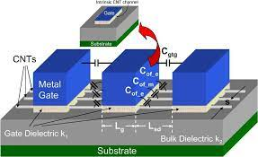
INTRODUCTION
CNTFET (Carbon NanoTube Field Effect Transistor ) :
A CNTFET refers to a field-effect transistor that utilizes carbon nanotube as the channel material instead of bulk silicon in the traditional MOSFET structure.
The Stanford CNTFET model uses a semiconducting single-walled CNT as a conduction channel, leading to better performance compared to the MOSFET and CMOS

Slide 5
Threshold Value :
The properties of CNTFET model are similar to those of MOSFETs, with the exception of the threshold voltage which depends on the diameter of the CNT, as stated in equation.
Vth = ( a · V π) / √ 3( e · Dcnt)
where V π = 3.033 ev (carbon bond energy)
a = 0.249 nm
Dcnt (diameter of CNT)

Slide 6
Advantages of CNTFET:
Low Power Consumption.
Electron mobility is High.
No Direct Tunneling.
Lower Threshold Voltage.
Gate Leakage current is reduced.

Slide 7
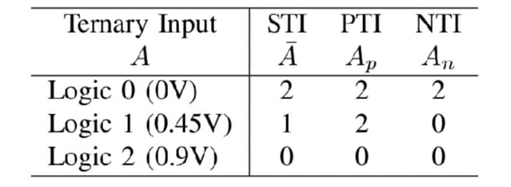
Ternary Logic:
A Ternary logic is a three-valued logic is a multiple-valued Logic (MVL)in which indicating false, True and some indeterminate third value (0,1,2).
It has 3 states of input as mentioned Standard Ternary Input(STI),Positive Ternary Input(PTI),Negative Ternary Input(NTI).

Slide 8
Advantages of Ternary Logic:
Reduce chip size.
The arithmetic and logic operations can be performed at higher speed.
Makes some calculations more efficient

Slide 9
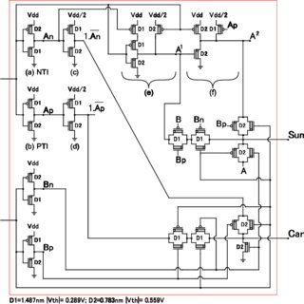
Implementation of Ternary Half adder using Unary Operators:

Slide 10
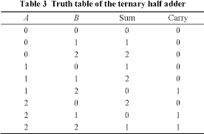
Truth Table :

Slide 11
Boolean Expression Reduction using unary operators :
Using Truth Table:
Sum = A.B₀ + (1.A₀ + 2.A₁ + 0.A₂).B₁ +(2.A₀ + 0.A₁ + 1.A₂).B₂
Carry = 0.B₀ + (0.A₀ + 0.A₁ + 1.A₂).B₁ +(0.A₀ + 1.A₁ + 1.A₂).B₂
After using Unary operators :
Sum = A.B₀ + A ₁ .B₁ + A ₂ .B₂
Carry = 0.B₀ + (1 · A_{p}).B₁ + (1 · A_{n}).B₂

Slide 12
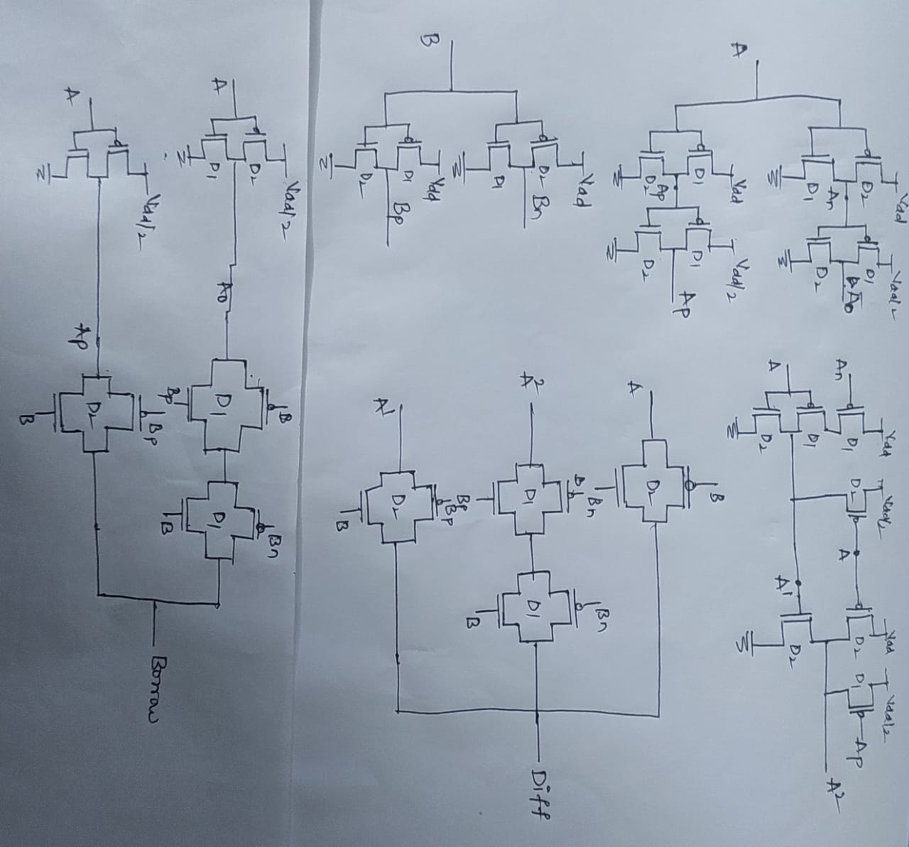
Implementation of Half subtractor using unary Operators:

Slide 13
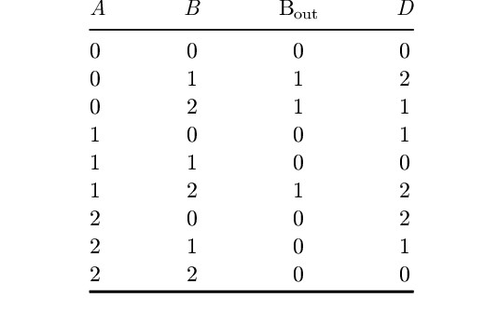
Truth Table of Ternary Half Subtractor:

Slide 14
Boolean Expressions for Ternary Half Subtractor:
Using unary operators:
Difference = A.B₀+ A^{2.} B₁ +A¹ .B₂
Borrow = A₀.B₁+ A_{p}. B₂

Slide 15
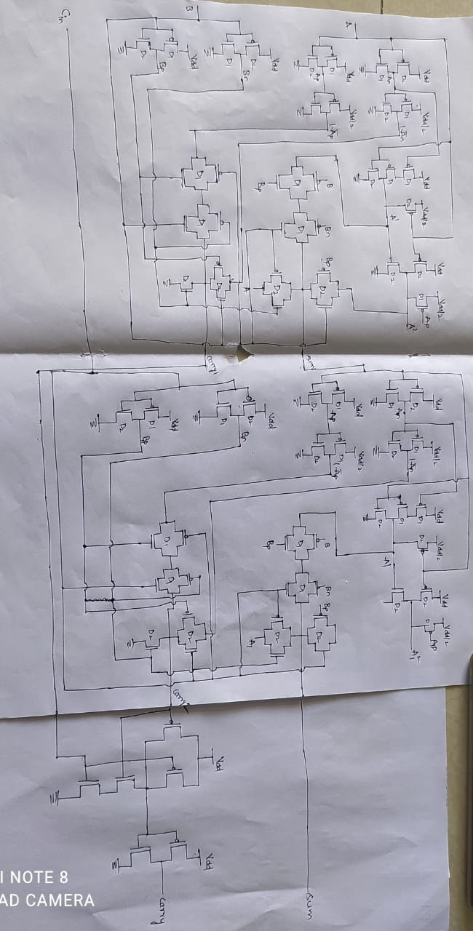
Implementation of Ternary Full adder using Ternary half adder:

Slide 16
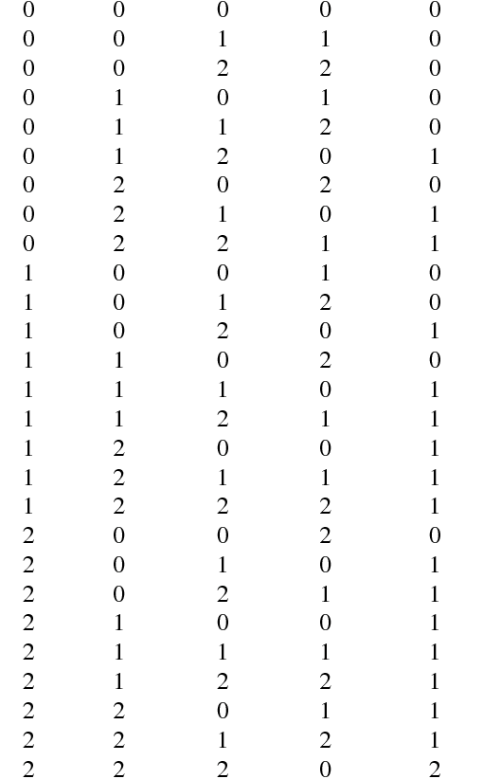
Truth Table of Ternary Full adder:
A
B
C
SUM
CARRY

Slide 17
Boolean Expressions for Ternary Full adder:
Sum = c₀ [b₀ · A + b₁ · A¹ + b₂ · A²]
+ c₁ [b₀ · A¹ + b₁ · A² + b₂ · A]
+ c₂ [b₀ · A² + b₁ · A+ b₂ · A¹]
Carry = c₀ [b₀. 0 +b₁. (1 . A_{p}) + b₂. (1.A_{n})]
+ c₁ [b₀. (1 . A_{p}) +b₁. (1 . A_{n}) + b₂ .1]
+ c₂ [b₀ . (1 . A_{n}) +b₁ .1 + b₂ . (1 +. A_{p})]

Slide 18
Operation of Ternary Half Adder:
Ternary Half Adder is a fundamental component for all arithmetic operations such as subtraction, multiplication, and division. Half adder is the simplest adder block which performs addition of two input signals.
It adds two binary digits where the input bits are termed as augend and addend and the result will be two outputs one is the sum and the other is carry. To perform the sum operation, XOR is applied to both the inputs, and AND gate is applied to both inputs to produce carry.

Slide 19
Operation of Ternary Half Subtractor:
A ternary half subtractor circuit takes two ternary numbers as inputs and subtracts one ternary number input from the other ternary number input, It has two target inputs, A (minuend) and B (subtrahend) and two target outputs, D (difference) and B-out (borrow).

Slide 20
Operation of Ternary Full Adder:
A ternary full adder is a circuit that will add two trits and a previous carry trit, and generate a sum trit and a carry trit . It can be implemented by using two ternary half adders and a binary OR gate.
Full Adder is an arithmetic circuit which performs the arithmetic sum of 3-input bits. It consists of 3 inputs and 2 outputs. One additional input is the Carry bit (C) in which represents the carry from the previous significant position.
We have two outputs Sum (S) and Carry (C), which can be obtained using the rules of Binary Addition.

Slide 21
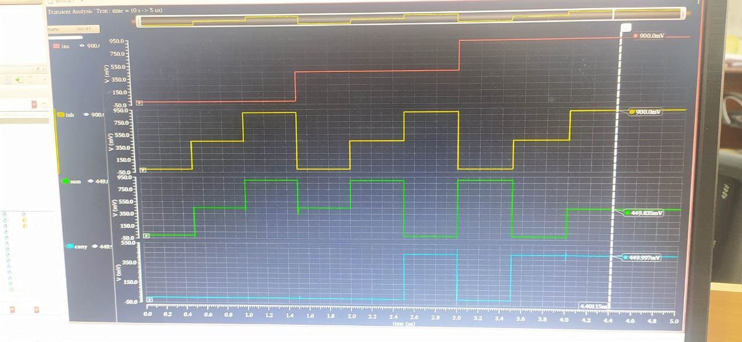
Simulation Result of Ternary Half Adder:

Slide 22
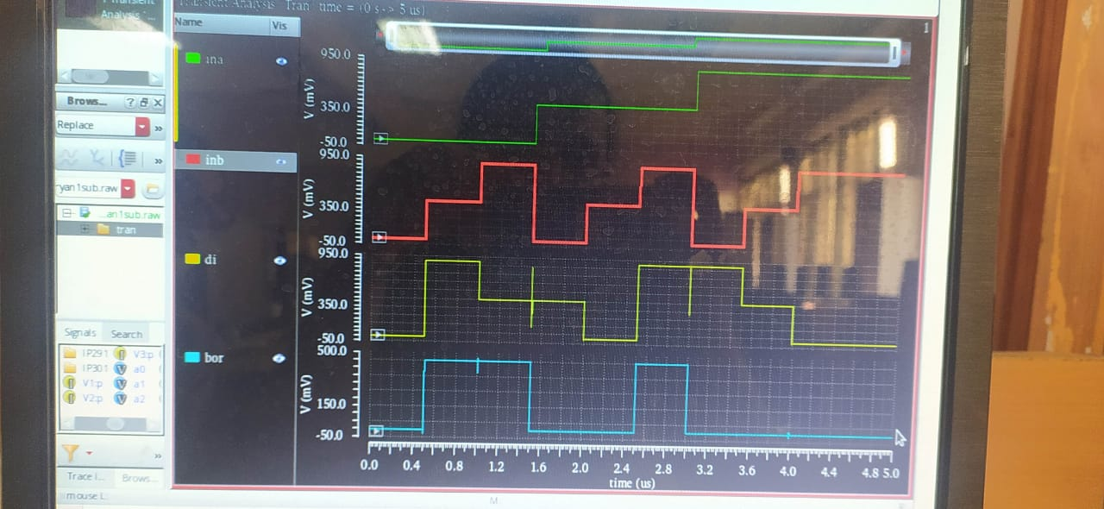
Simulation Result of Ternary Half Subtractor:

Slide 23
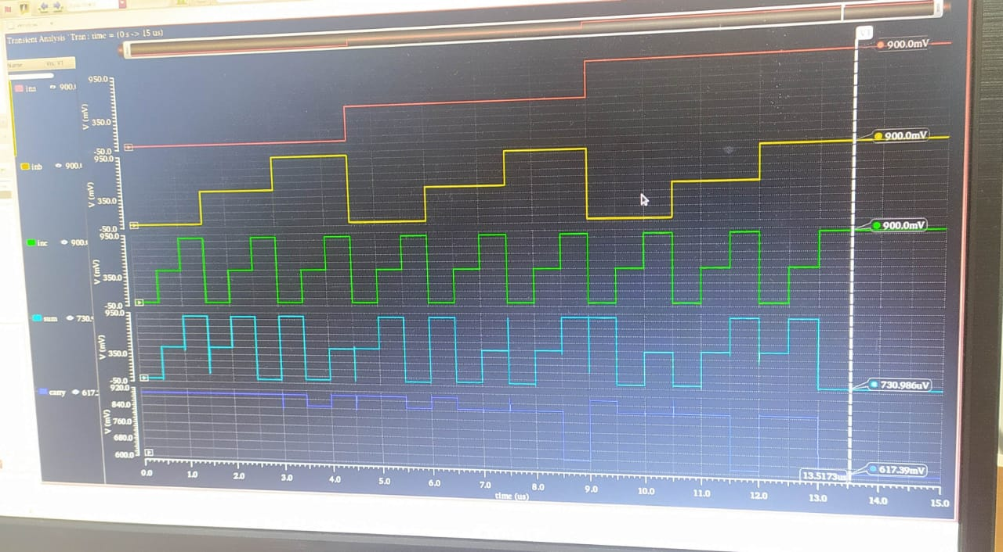
Simulation Result of Ternary Full Adder:

Slide 24
Simulation Result
For Half Adder, We have designed the whole circuit and the simulation is done.
For Half Subtractor, we have designed the circuit and the simulation is done.
For Full Adder, we have designed the circuit and the simulation is done only for sum combinations ,we didn’t got some of the waveforms for carry combinations.

Slide 25
Work Plan
Design of Ternary Half Adder , Half Subtractor , Full Adder , Full Subtractor.
Implementation of the proposed design using cadence tool to achieve objectives.

Slide 26
Work Done
Implementation of conventional circuits (Half Adder, Half Subtractor, Full Adder)
Knowledge of tool

Slide 27
References
W. Zhao and G. Prenat, Eds., Spintronics-based Computing. Cham: Springer International Publishing, 2015. [Online]. Available: http://link.springer.com/10.1007/978-3-319-15180-9
F. Etemadi, P. Heydari, and H. Jafarkhani, “On Analog QAM Demodulation for Millimeter-Wave Communications,” IEEE Transactions on Circuits and Systems II: Express Briefs, vol. 66, no. 3, pp. 402–406, Mar. 2019. [Online]. Available: https://ieeexplore.ieee.org/document/8402108/
N. Saleh, A. Kassem, and A. M. Haidar, “Energy-Efficient Architecture for Wireless Sensor Networks in Healthcare Applications,” IEEE Access, vol. 6, pp. 6478–6486, 2018. [Online]. Available: http://ieeexplore.ieee.org/document/8247183/

Slide 28
THANK YOU

